Slide 1
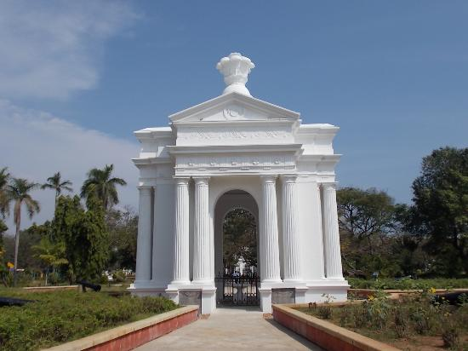
GOVERNMENT OF PUDUCHERRY
MID-DAY MEAL SCHEME 2020-21

Slide 2
Salient Features…
Covers Pre-Primary & 9,10,11& 12 students under State Resources.
Break Fast scheme 100ml of Hot milk to the students – Rs.1239.50 lakhs under State fund.
Food is prepared in modernized central kitchens and cluster kitchens in a hygienic atmosphere.
Egg is provided to students twice a week amount Rs.220 lakhs(U.T Fund)
Safe drinking water with RO Systems
All central kitchens and cluster kitchens use LPG
Procurement of Agmark diet articles through Co-operative institutions / Govt. undertakings by limited tender system
Developing Nutrition Kitchen Garden in Schools
Cooking Competition conducted for cooks.

Slide 3
BEST PRACTICES 2019-20

Slide 4
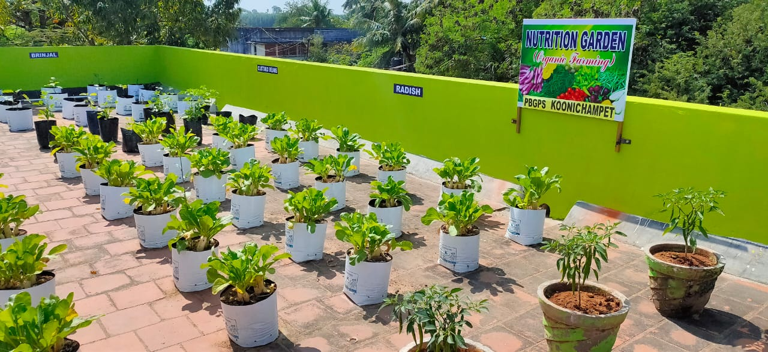
KITCHEN GARDENS

Slide 5
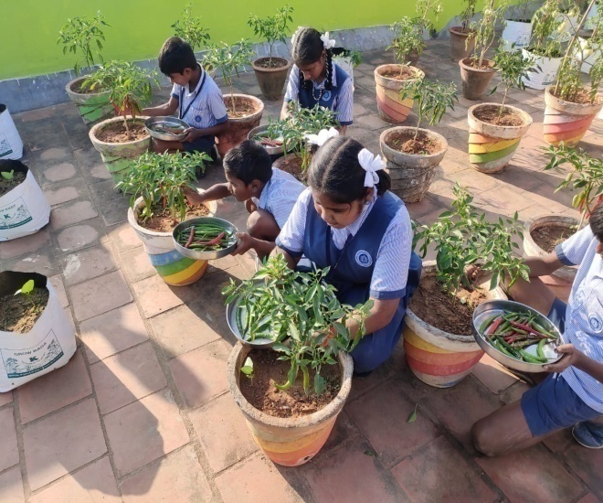
PICKING OF VEGETABLES

Slide 6
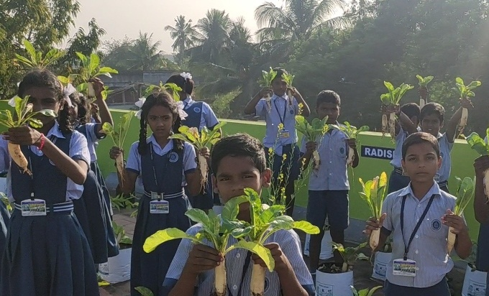
VEGETABLES FOR COOKING

Slide 7
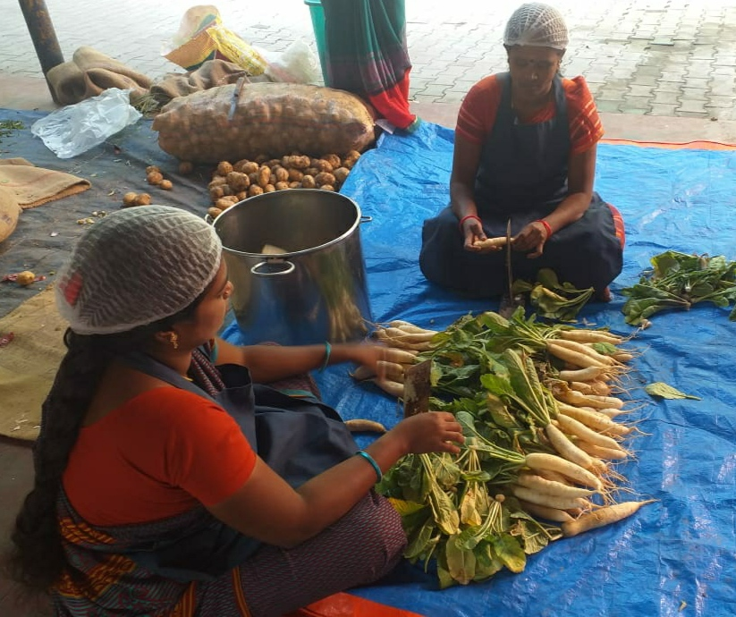
GARDEN VEGETABLES USED IN SCHOOL KITCHEN

Slide 8
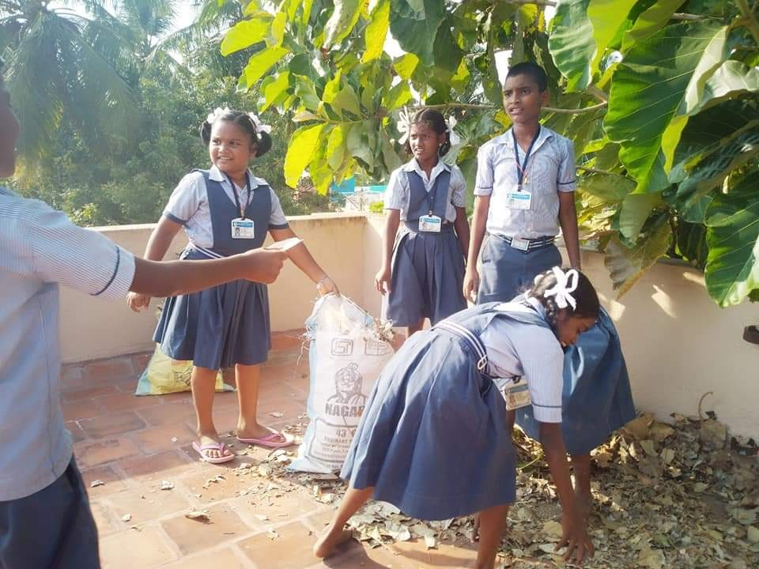
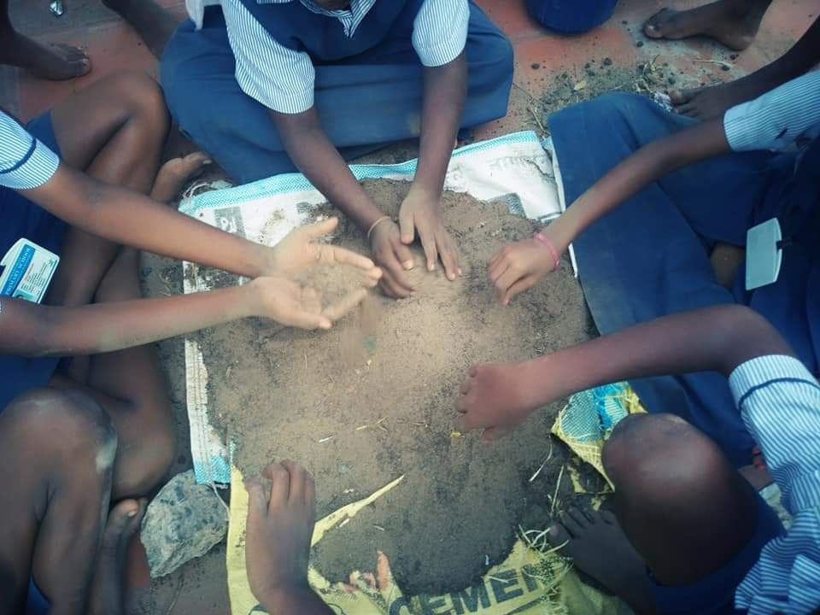
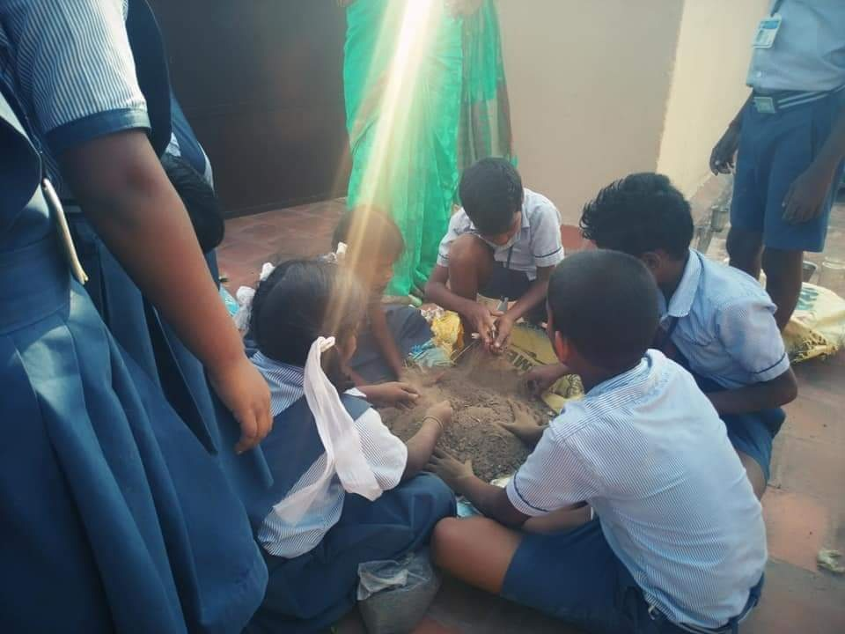
ORGANIC FARMING IN THE SCHOOLS

Slide 9
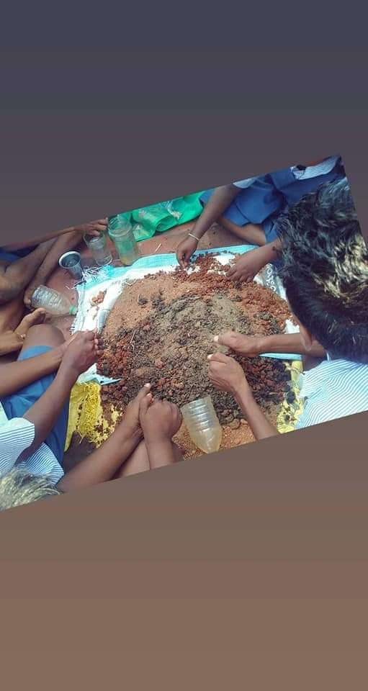
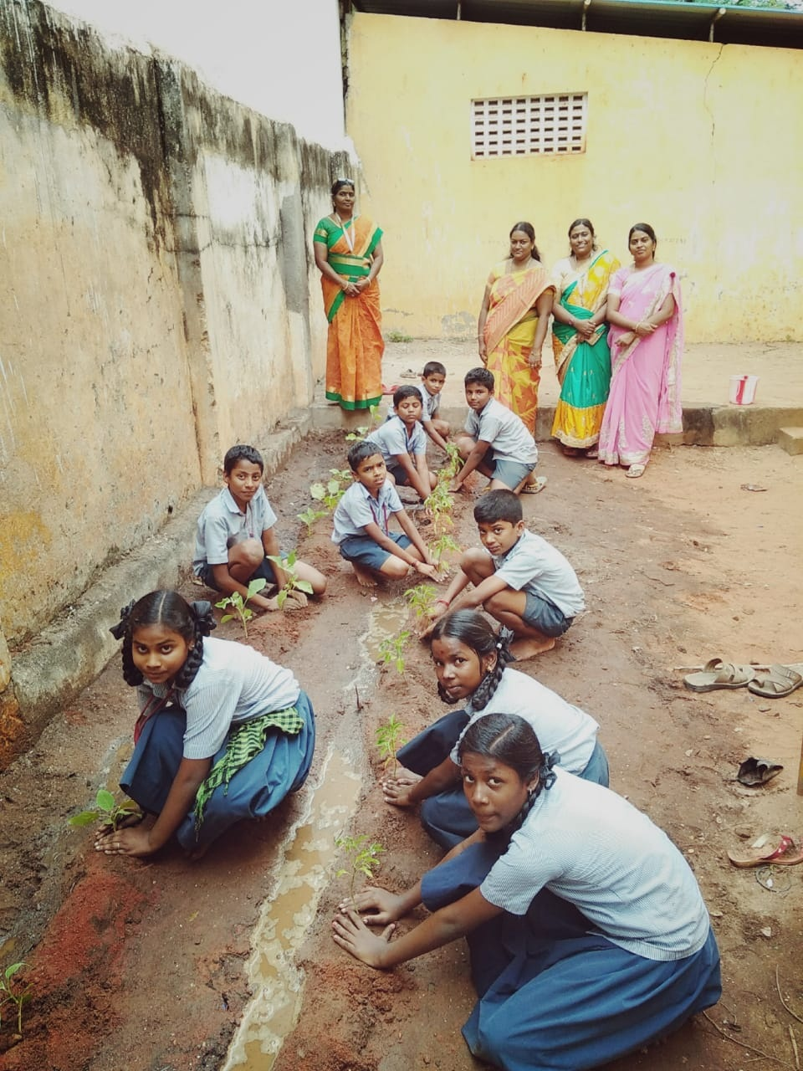
DEVELOPING KITCHEN GARDEN IN SCHOOLS

Slide 10
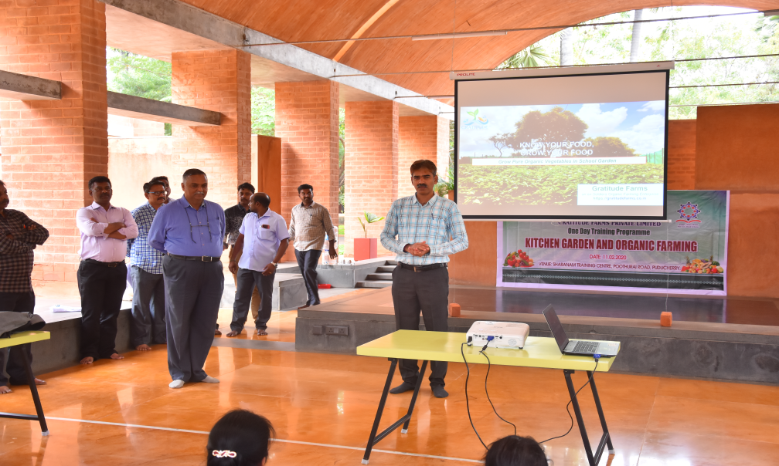
ONE DAY TRAINING PROGRAMME ON KITCHEN GARDEN AND ORGANIC FARMING

Slide 11
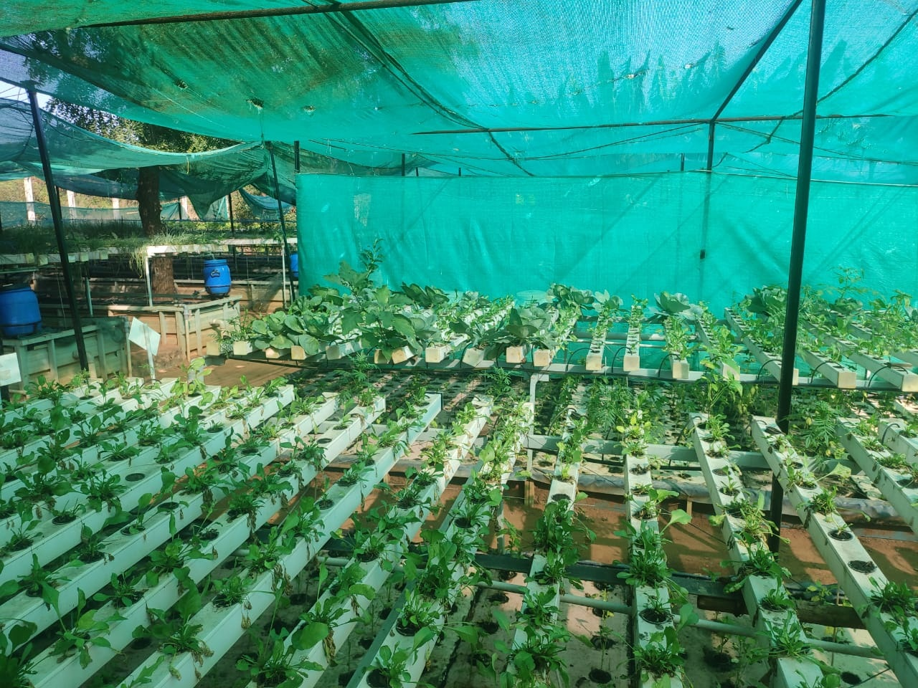
KITCHEN GARDEN AND ORGANIC FARMING

Slide 12
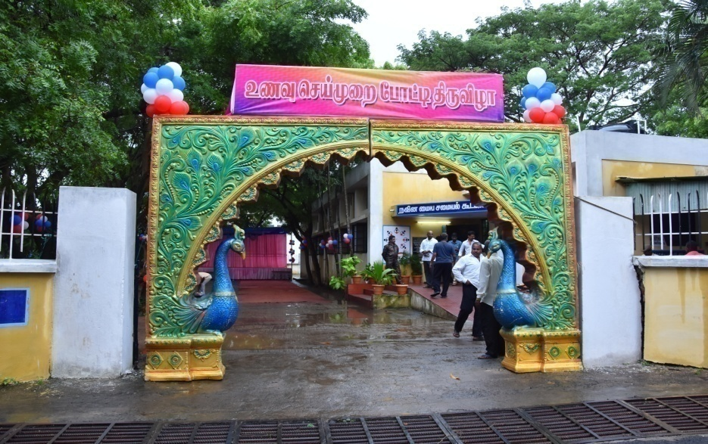
COOKING COMPETITION

Slide 13
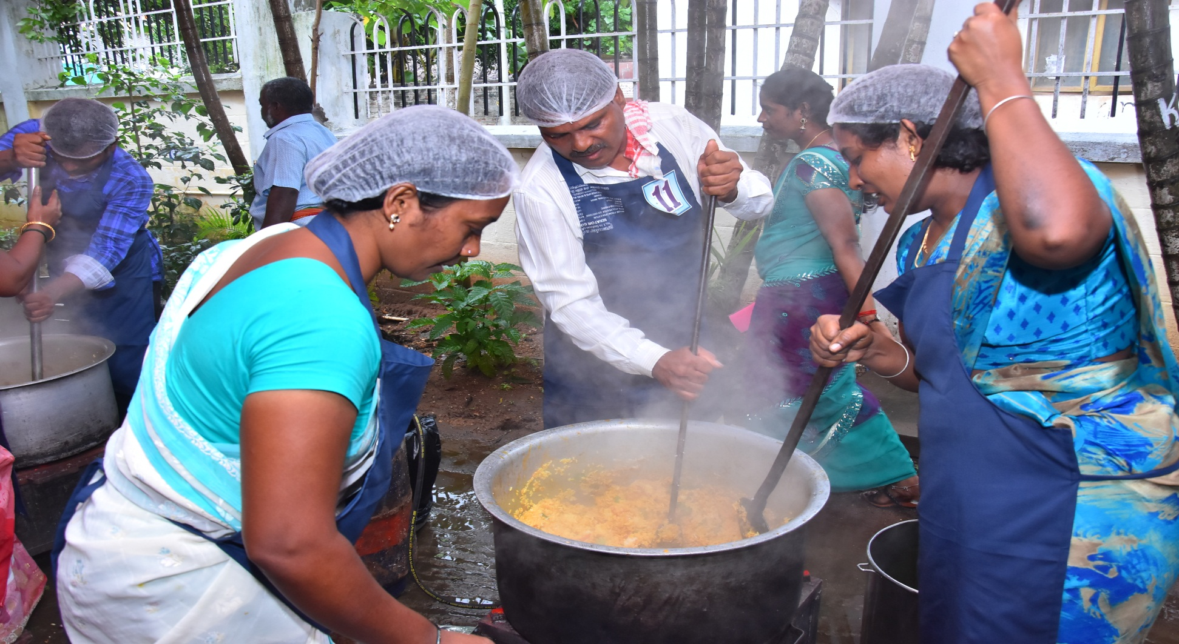
COOKING COMPETITION-COOKING PROCESS

Slide 14
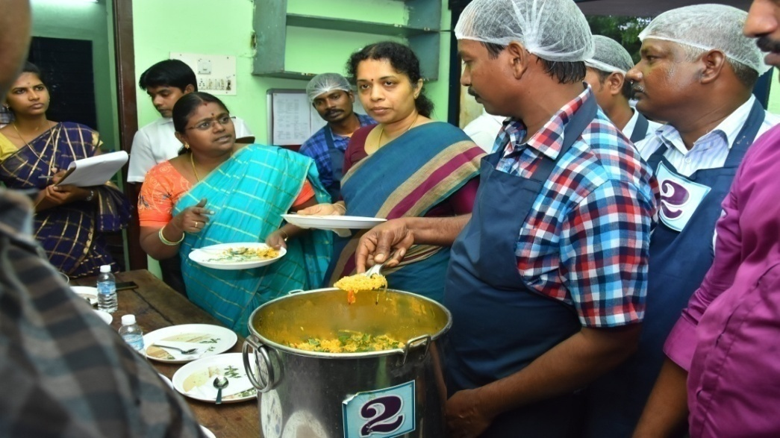
RECIPE TASTED BY THE JUDGES

Slide 15
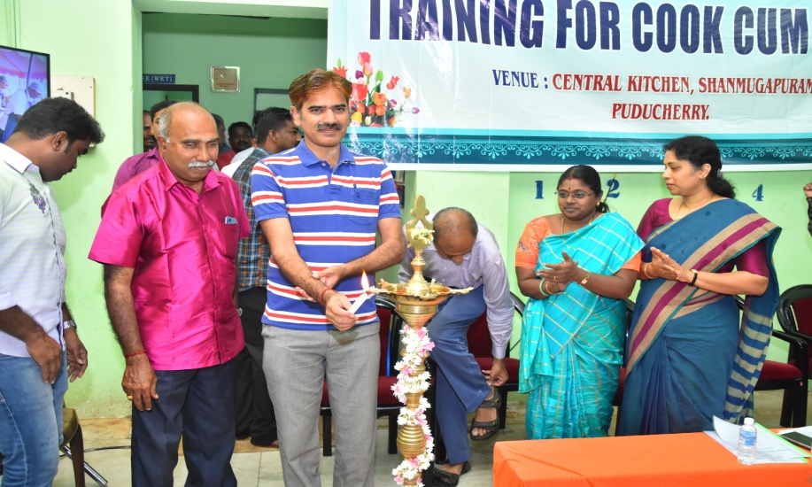
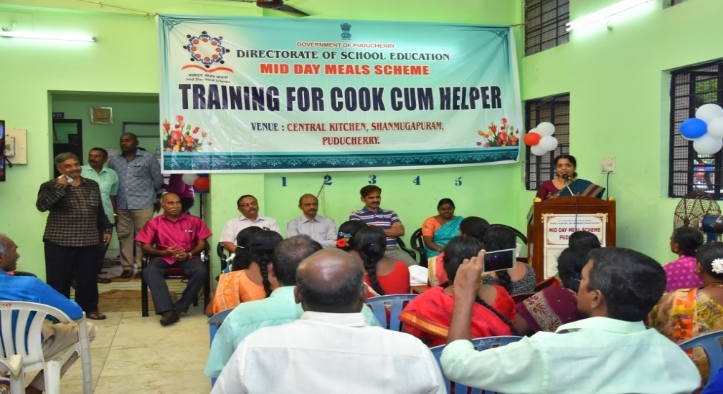
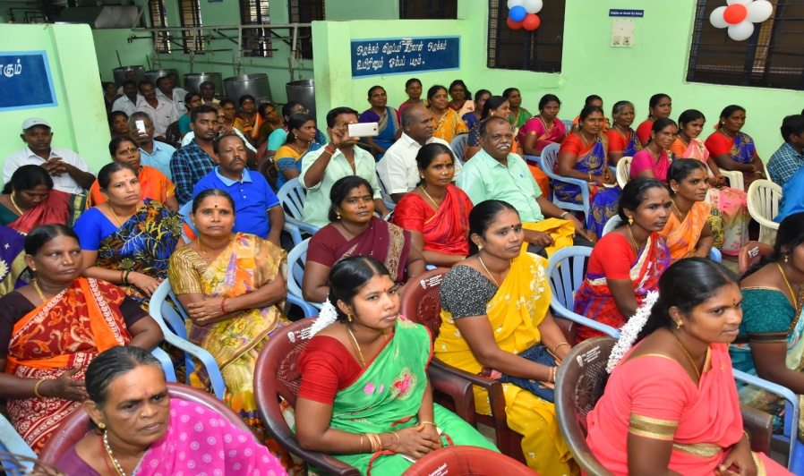
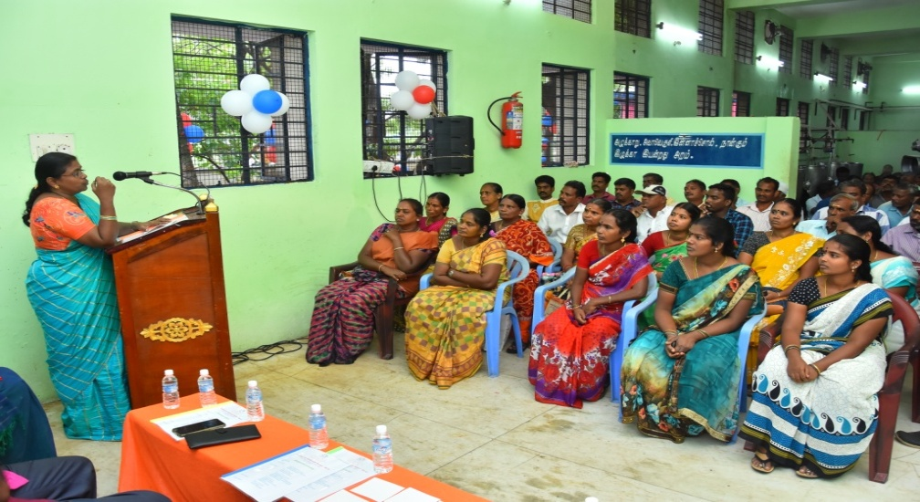
TRAINING PROGRAMME TO COOK CUM HELPER
TRAINING PROGRAMME FOR COOK CUM HELPERS

Slide 16
Action Taken on 2019-20
Less coverage of children- At upper Primary level the coverage is 75% against enrollment is 82%. In the District of Karaikal the coverage of children is 66% only at upper Primary level. | Action has been taken, it is ensured that the students studying in Govt aided schools are also taking Midday Meal regularly.
Less coverage of working days-203 days Primary Level –PAB approved 210 days Upper Primary Level-PAB approved 220 days | Scheduled to reopen on 3rd June 2018 But due to hot weather condition schools reopened only on 12.06.2018. And also incessant rain leads to closure of schools for a few more days .Hence, less coverage of working days against the PAB.
Delay in construction of kitchen-cum-stores- 13 Kitchens are in progress | 9 kitchen cum stores has been constructed and completed in karaikal region. The remaining 4 is under process. And will be completed with in this academic year.
Low utilization of MME funds. Only 5% funds has been utilized against the allocation under MME | Action has been taken,62% expenditure incurred upto 3rd Quarter remaining funds will be spent in the 4th quarter.
Social Audit under Mid Day Meal Scheme is yet to be initiated | Proposal has been submitted to Government,. The Government suggested and recommended to conduct Social Audit under Midday Meal Scheme through a professional Agency for karaikal districts, remaining districts will be audited in a phased manner.

Slide 17
PROGRESS FOR THE YEAR 2019-20
LEVEL | STANDARD | PAB APPROVAL 2019-20 | STUDENTS STRENGTH | MDM BENEFICIARIES | Percentage
Primary | I to V | 26000 | 27279 | 26368 | 96%
Upper Primary | VI to VIII | 19000 | 21148 | 18609 | 87.9%
Total |  | 45000 | 48427 | 44977 | 92.3%
Total no. of schools =426/429

Slide 18
ACHIEVEMENT DURING THE FY 2019-20
Average number of children availed MDM

Slide 19
Cooking cost 2019-20
Year | Primary |  |  |  | Upper Primary
2019-20 | Central-60% | UT-40% | Add. UT fund | Total | Central-60% | UT-40% | Add. UT fund | Total
 | 2.69 | 1.79 | 4.42 | 8.90 | 4.03 | 2.68 | 4.69 | 11.40
2020-21 (Proposed) | 2.69 | 1.79 | 4.87 | 9.35 | 4.03 | 2.68 | 4.84 | 11.55

Slide 20
STANDARD MENU
MONDAY | Rice, Mixed Vegetable Sambar, Potato Poriyal & Egg
TUESDAY | Variety Rice – Tomato Rice with Potato and Carrot Poriyal
WEDNESDAY | Rice, Mixed Vegetable Sambar, Beetroot Poriyal & Egg
THURSDAY | Variety Rice – Tamarind Rice with Potato Poriyal
FRIDAY | Rice, Mixed Vegetable Sambar, Raw Banana Poriyal
Sambar : Dhall with mixed vegetables like Brinjal, Ladies Finger ,Beans, Drumstick and Cabbage,Chow Chow, Knol Khol, Carrot based on the availability:
Black channa/Mochai provided on Non Egg days

Slide 21
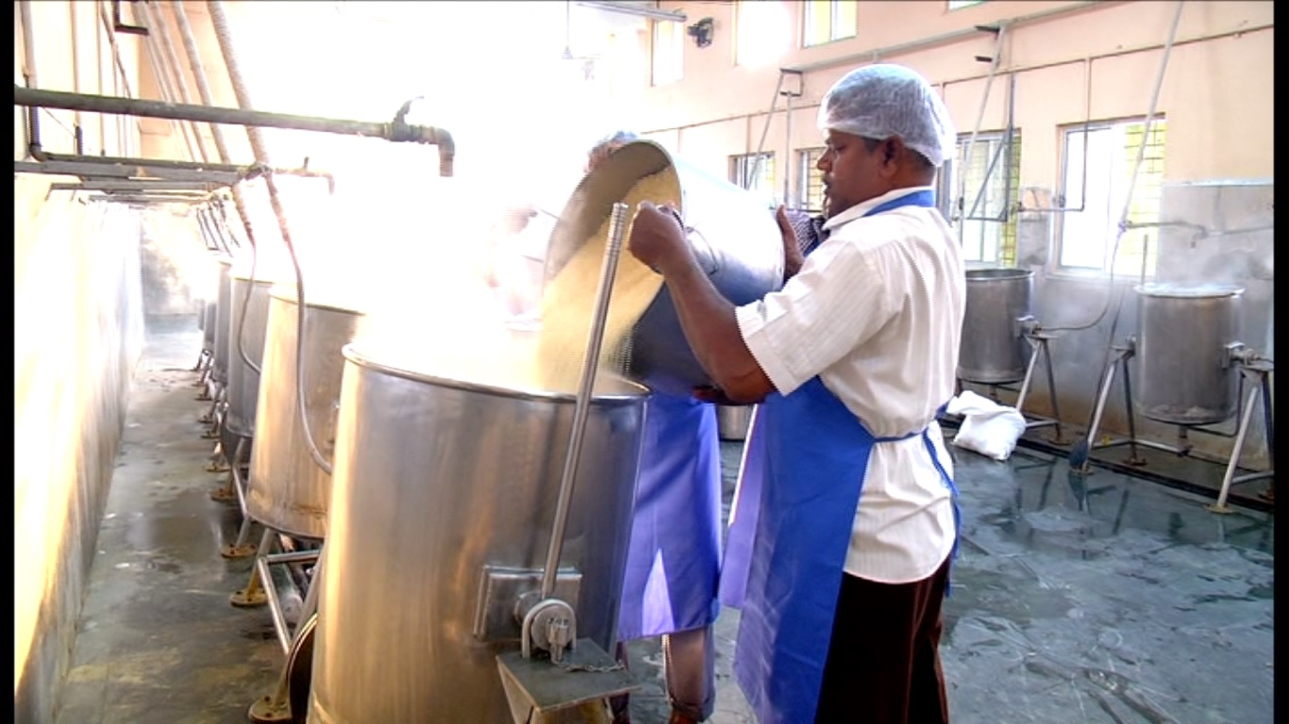
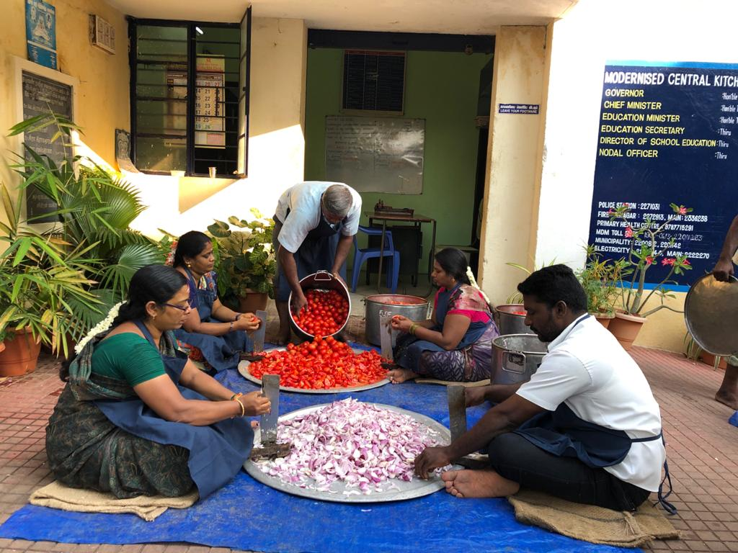
Cooking Process in Central kitchen

Slide 22
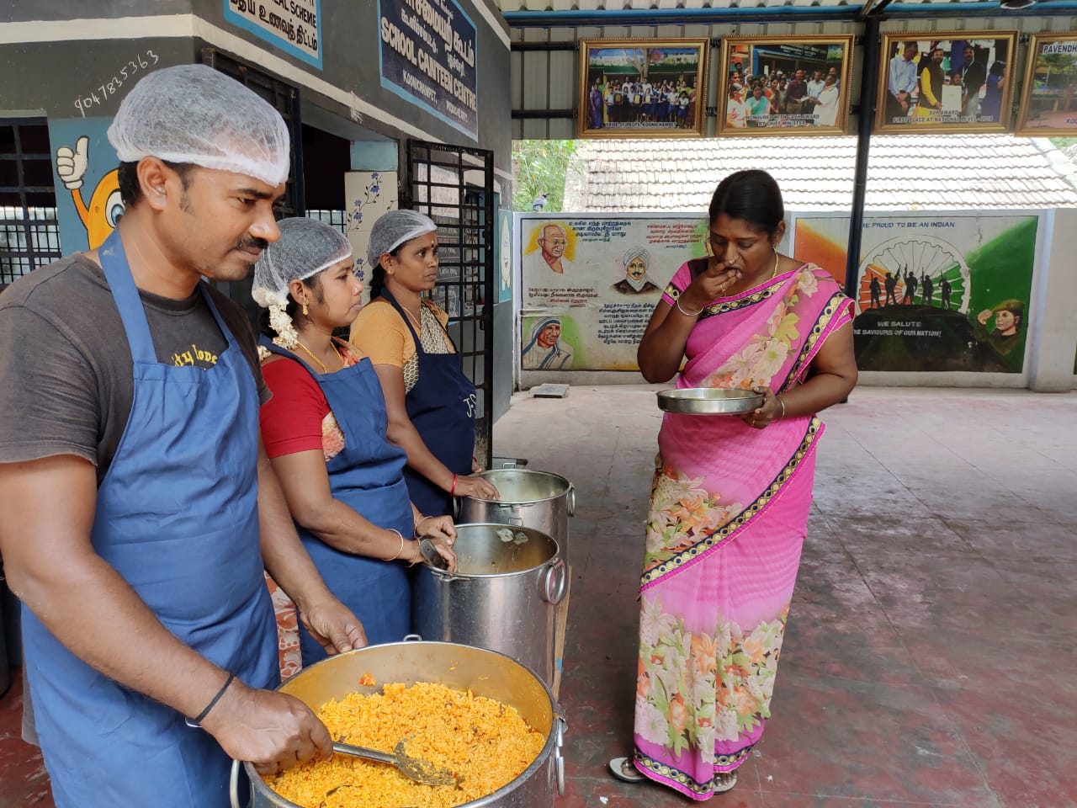
TEACHER TASTING THE FOOD BEFORE SERVING

Slide 23
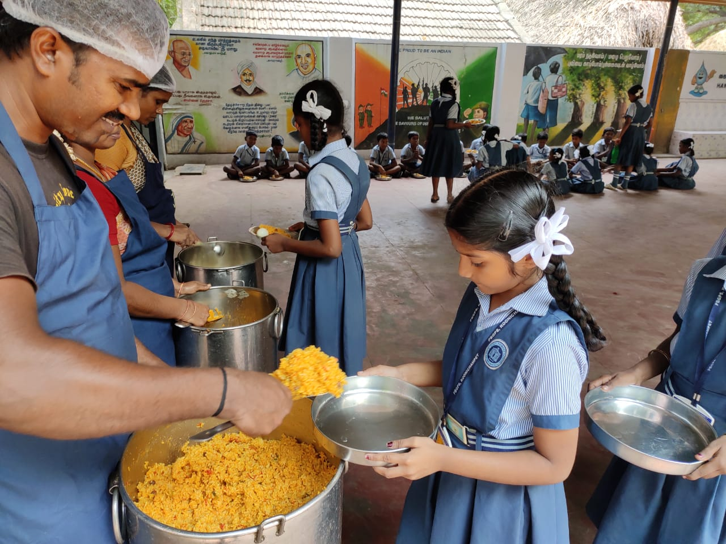
MIDDAY MEAL SERVED TO THE STUDENTS

Slide 24
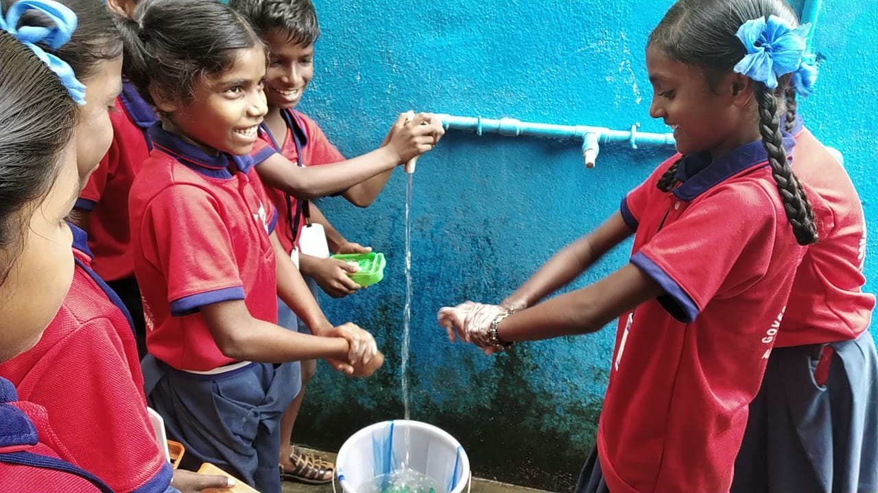
HAND WASH

Slide 25
SCHOOL HEALTH PROGRAM 2019-20
Total No. of Schools covered – 426
Distribution of Iron & Folic Acid, Vitamin A & De-worming Tablets
Distribution of Spectacles – 412 Students

Slide 26
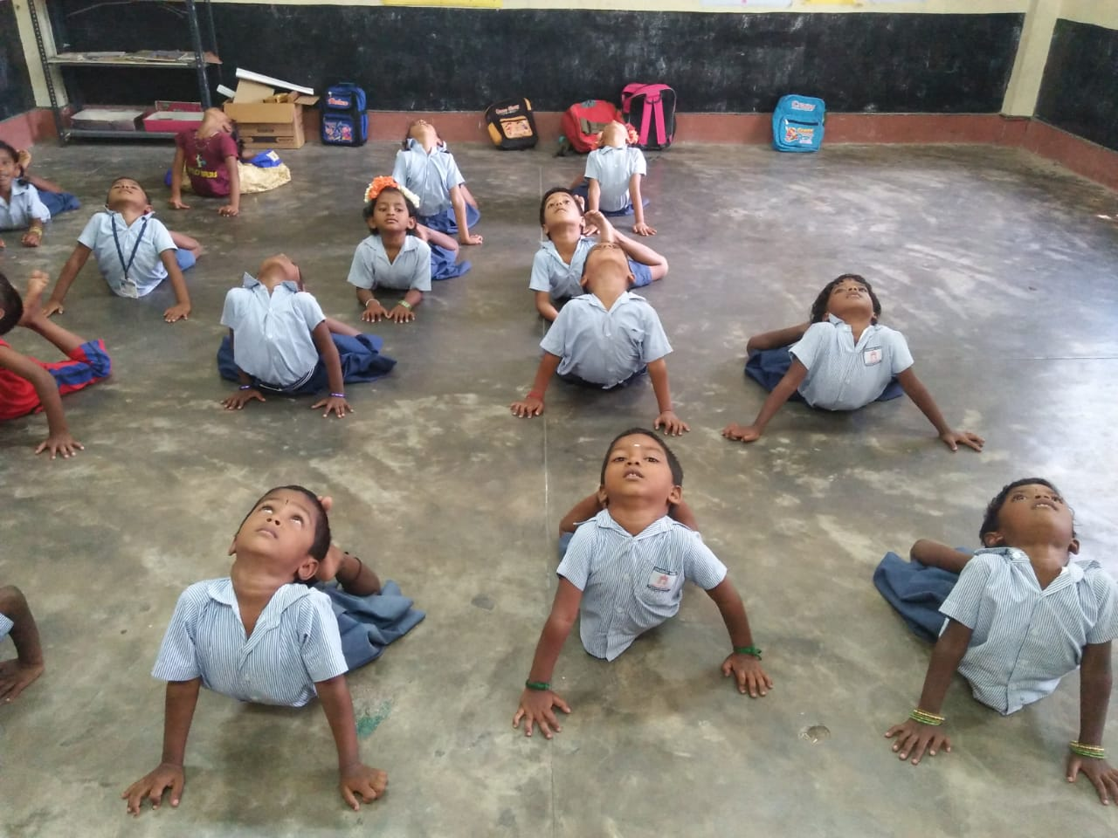
YOGA

Slide 27
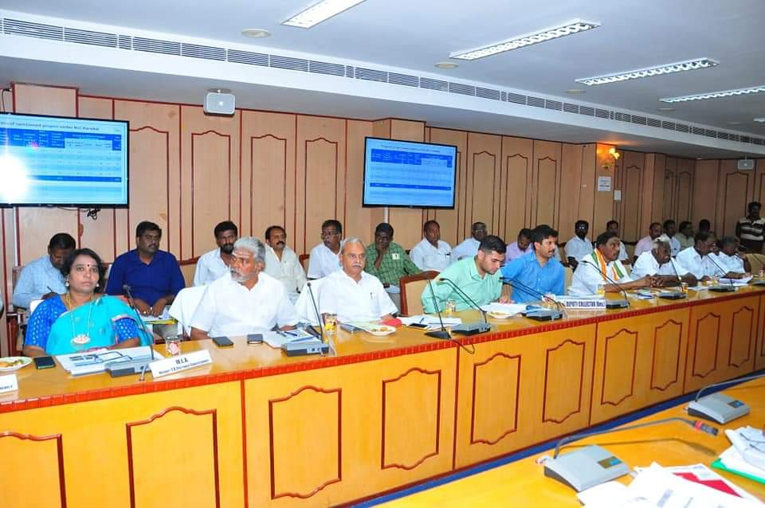
District Level Committee Meeting - Karaikal
Hon’ble M.P (Lok Sabha) Chairperson, Education Minister ,District Collector, & other officials , meeting held on Feb’2020

Slide 28
Shri Rajiv Gandhi Breakfast scheme 2019-20
Region | Total No. of Beneficiaries (From Pre-primary to 12th Std) | Cost of 100 ml / per student In Rs.
Puducherry | 37340 | 8.17
Karaikal | 13500 | 7.34
Mahe | 2950 | 7.88
Yanam | 4000 | 7.88
Total | 57790
OUTLAY -2019-20 Rs. 1239.50 lakhs

Slide 29
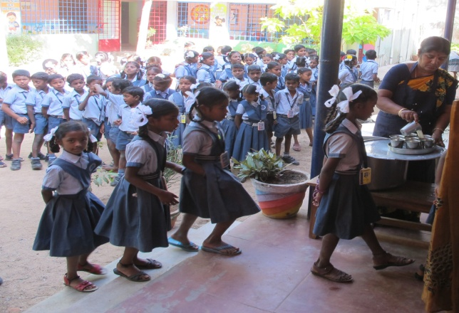
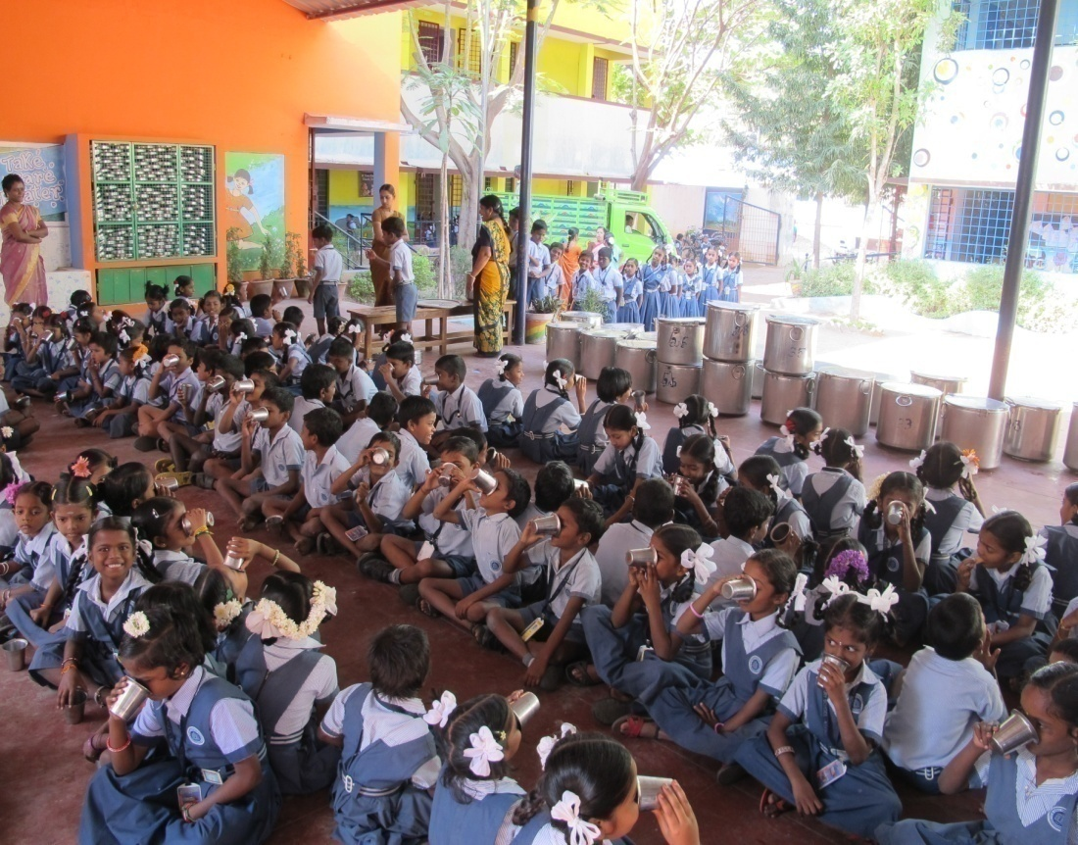
PROVIDING HOT MILK

Slide 30
Expenditure – 2019-20 upto Dec’19
Rs. in lakhs
NUTRITION Mid Day Meal | Allocation | Opening balance | Released | Total | Expenditure as on 31.12.2019 | Percentage
Central 60% | 422.9 | 139.7 | 290 | 429.7 | 295.1 | 69%
State-40% | 236.7 | 0 | 236.7 | 236.7 | 236.7 | 100%
Additional U.T fund | 1287.50 | 0 | 1287.50 | 1287.50 | 965.62 | 75% (upto Dec’19)

Slide 31
ACTION PLAN-2020-21
Completion of 4 Kitchen cum stores
Developing kitchen Gardens in 68 Schools.
Conducting Social Audit by professional Agency
100% schools to be covered under AMS.
Conducting cooking competition to 2 districts.

Slide 32
BUDGET PROPOSAL 2020-21

Slide 33
ACHIEVEMENT FOR THE YEAR 2019-20
LEVEL | STANDARD | PAB APPROVAL | STUDENTS STRENGTH | MDM BENEFICIARIES
Primary | I to V | 26000 | 27279 | 26368
Upper Primary | VI to VIII | 19000 | 21148 | 18609
Total |  | 45000 | 48427 | 44977
PROPOSAL FOR THE YEAR 2020-21
LEVEL | STANDARD | PAB APPROVAL 19-20 | MDM BENEFICIARIES (PROPOSAL)
Primary | I to V | 26000 | 26828
Upper Primary | VI to VIII | 19000 | 18700
Total |  | 45000 | 45528

Slide 34
FINANCIAL PROGRESS
(in lakhs)
COMPONENT | PAB APPROVAL 2019-20 | PROPOSAL 2020-21
Recurring | 422.92 | 434.91
Non Recurring | - | 22.50
Total | 422.92 | 457.41

Slide 35
BUDGET PROPOSAL 2020-21
( in lakh)
Component | Central Assistance-60% |  |  | State 40%(Manadatory) |  |  | Grand Total
 | Primary | Upper Primary | Total | Primary | Upper Primary | Total
Cost of Food grains | 16.90 | 18.51 | 35.41 |  |  |  | 35.41
Cooking Cost | 151.55 | 165.79 | 317.35 | 100.85 | 110.26 | 211.10 | 528.45
Honorarium to Cook-cum-Helper | 33.36 | 28.50 | 61.86 | 22.25 | 19.00 | 41.25 | 103.11
Transportation Assistance | 4.23 | 4.63 | 8.85 |  |  |  | 8.85
MME | 5.56 | 5.87 | 11.43 |  |  |  | 11.43
Total - A | 211.60 | 223.31 | 434.91 | 123.10 | 129.26 | 252.35 | 687.26
Non Recurring Assistance
Kitchen-cum-Store |  |  | 22.50 |  |  | 15.00 | 37.50
Total-B |  |  | 22.50 |  |  | 15.00 | 37.50
Total(A+B) | 211.60 | 223.31 | 457.41 | 123.10 | 129.26 | 267.35 | 724.76

Slide 36
PROPOSAL - MME PLAN 2020-21
UT. PUDUCHERRY
Rs. in lakhs
 | Activities | Districts
I | School Level Expenses | Puducherry | KKL | Mahe | Yanam | Total
 | Training for Cook Cum Helper | 10 | 8 | 3 | 4 | 25
 | Repair and Maintenance of Cooking devices, Utensils
 | Eating Plates (SS) upper primary
 | Storage Bin
 | Soap – Hand wash
 | Printing & Stationary
 | Sub Total | 10 | 8 | 3 | 4 | 25
II | Management, Supervision, Training, Internal Monitoring and External Monitoring. | Puducherry | KKL | Mahe | Yanam | Total
 | i) Hiring charges of manpower at various levels | 1.5 | 0.5 | 0.5 | 0.5 | 3
 | ii) Transport & Conveyance | 4 | 0.5 | 0.25 | 0.25 | 5
 | iii) Office expenditure | 0.5 | 0.25 | 0.1 | 0.15 | 1
 | iv) Furniture, hardware and consumables etc. | 0.4 | 0.2 | 0.2 | 0.2 | 1
 | v) Capacity building of officials | 0.5 | 0.25 | 0.1 | 0.15 | 1
 | vi) Publicity, Preparation of relevant manuals | 0.5 | 0.3 | 0.1 | 0.1 | 1
 | vii) External Monitoring & Evaluation |  |  |  |  | 0
 | MDM – IVRS MOBILE APPS & SMS | 2 | 0.5 | 0.25 | 0.25 | 3
 | MDM - SOCIAL AUDIT | 2 | 3 | 0.5 | 0.5 | 6
 | IEC Activities | 0.25 | 0.25 | 0.25 | 0.25 | 1
 | TA/DA for MDM officials attending Workshops | 2.5 | 0.3 | 0.1 | 0.1 | 3
 | Sub Total | 14.15 | 6.05 | 2.35 | 2.45 | 25
 | Grand Total | 24.15 | 14.05 | 5.35 | 6.45 | 50
ADDITIONAL SECRETARY TO GOVERNMENT (EDUCATION)

Slide 37
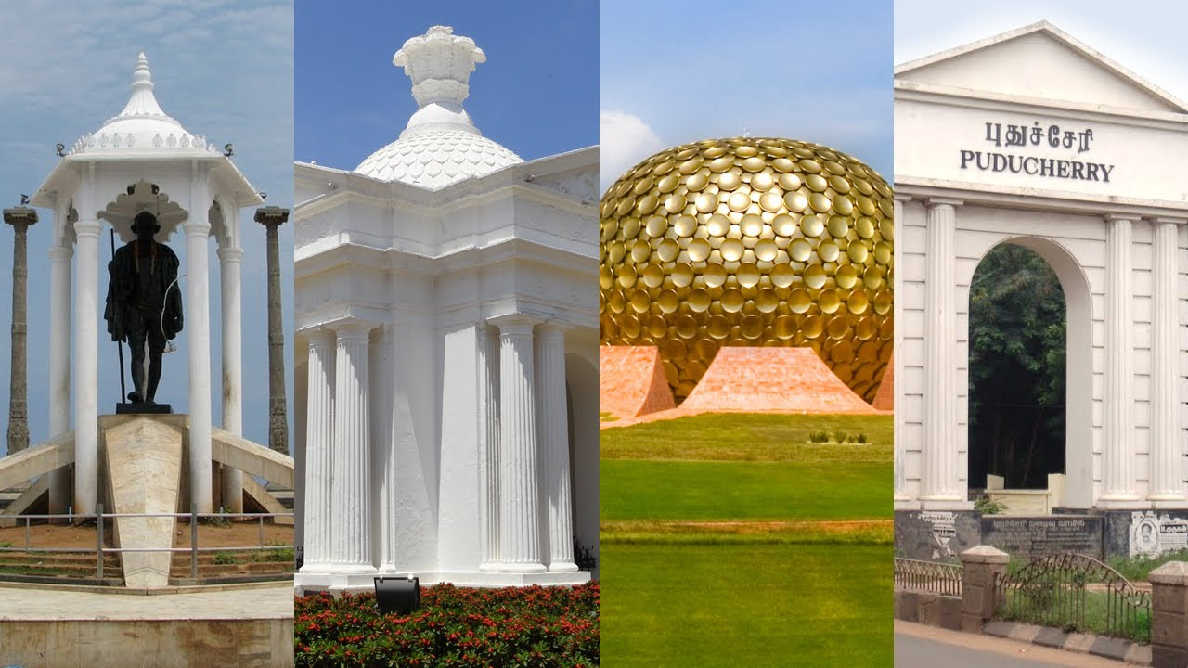
T H A N K Y O U

Slide 38
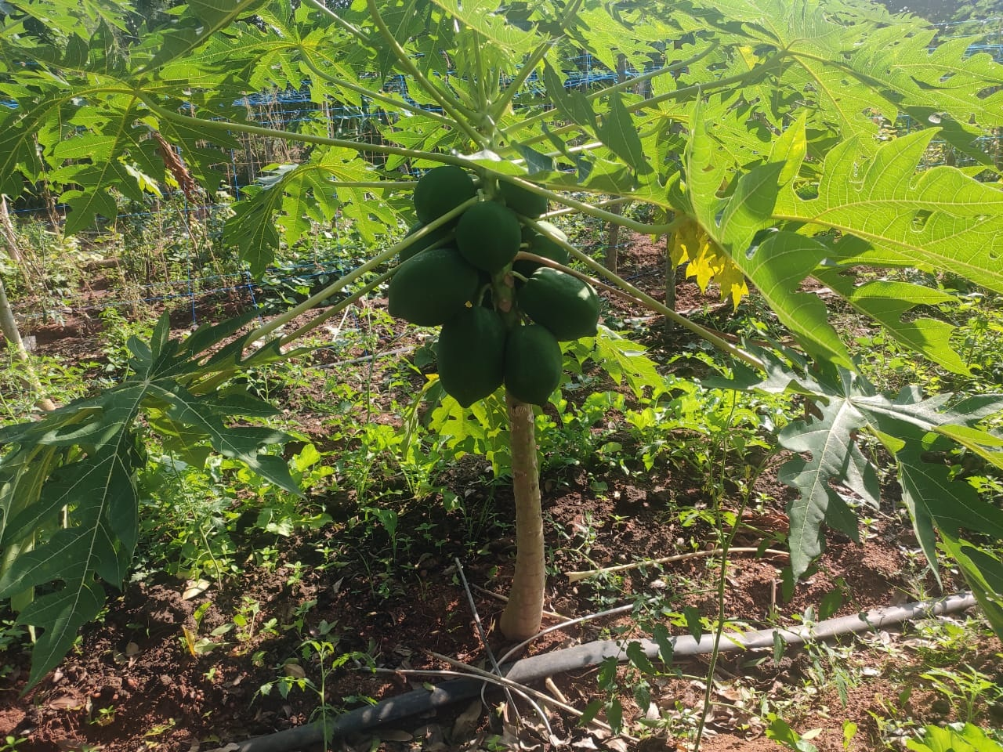
THANK YOU

